Slide 1
Chapter 4
Extended Entity-Relationship (EER) Modeling

Slide 2
Limitation of ER Model
Entity Set Person represent all kinds of persons: Student, Employee, Instructor, etc.
There is no way to distinguish them in ER model as there is no support for
Specialization:
Generalization:
Union
top-down
bottom-up
Person
Student
Employee
UnderGrad
GradStudent
Instructor
Head

Slide 3
EER Model
EER stands for Extended ER
Includes all modeling concepts of basic ER Model
Additional concepts:
subclasses/superclasses
specialization/generalization
categories (UNION types)
attribute and relationship inheritance
These are fundamental to conceptual modeling
The additional EER concepts are used to model applications more completely and more accurately
EER includes some object-oriented concepts, such as inheritance

Slide 4
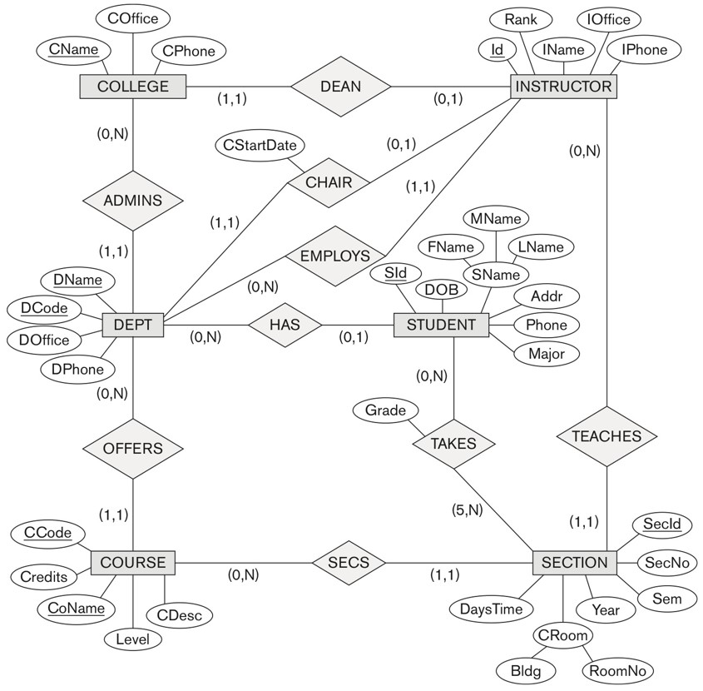

UNIVERSITY database conceptual schema
Entity sets are not disjoint

Slide 5

Subclasses and Superclasses
An entity set may have additional meaningful subgroupings of its entities
Person
ISA
Employee
Student
ISA
ISA
Instructor
Secretary
Undergrad
GradStudent
EER diagrams extend ER diagrams to represent these additional subgroupings, called subclasses

Slide 6
ISA Hierarchy and Inheritance
Name
E#
Loc
Employee
worksIn
Department
rate
hours
ISA
C#
Hourly Empl
Salaried_Empl
As in C++, Java or other PLs, a subclass inherits
attributes
relationships
If we declare A ISA B, every A entity is also considered to be a B entity.

Slide 7
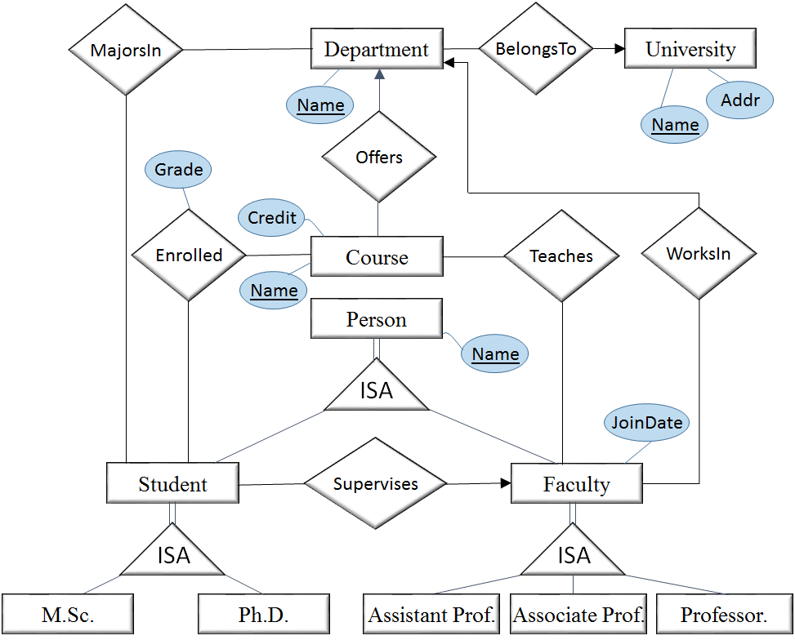
An Example

Slide 8
Specialization
Specialization is a top-down design process of defining a set of subclasses of a superclass
These subgroupings become lower-level entity sets that have attributes or participate in relationships that do not apply to the higher-level entity set.
The set of subclasses is based upon some distinguishing characteristics of the entities in the superclass
{INSTRUCTOR, SECRETARY} is a specialization of EMPLOYEE based upon job type.
{SALARIED_EMP, HOURLY_EMP} is another specialization of EMPLOYEE based upon .
A superclass may have several specializations

Slide 9
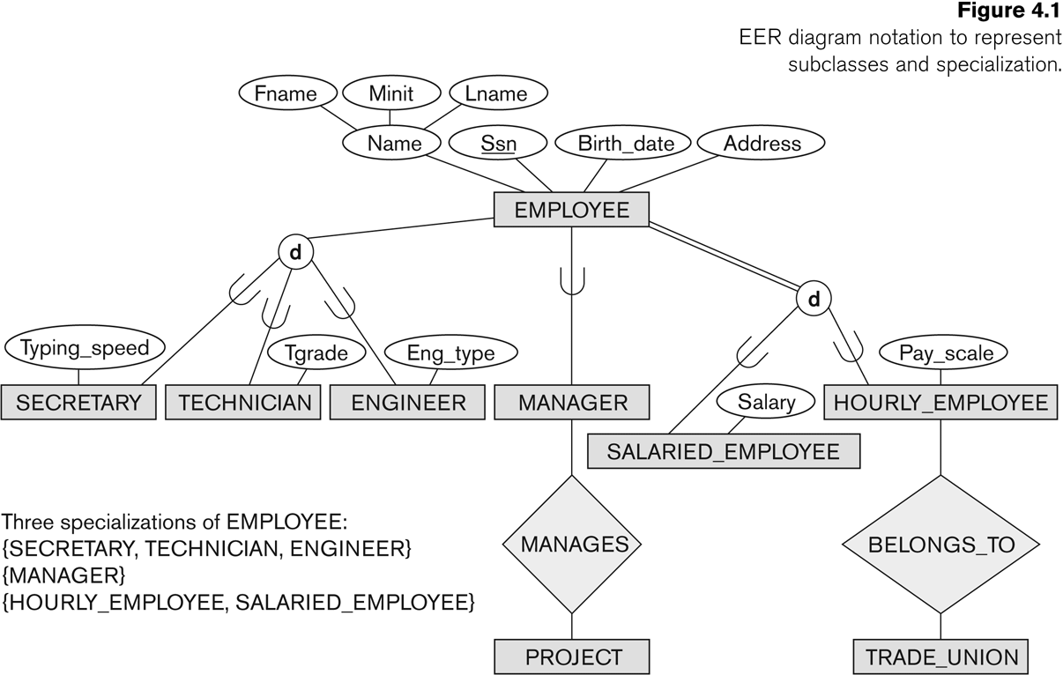
Specialization in EER Diagrams

Slide 10
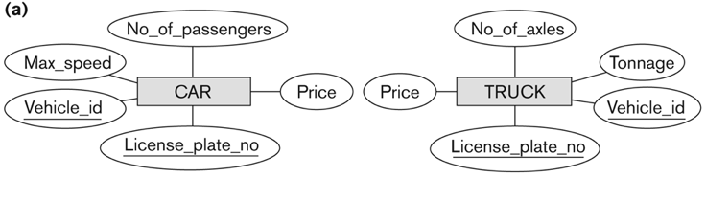
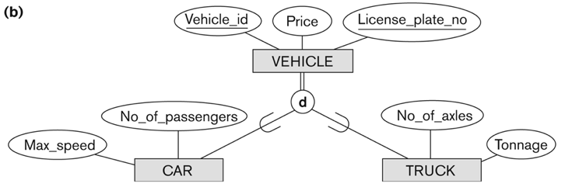
Generalization

Slide 11
Generalization
A bottom-up design process – combine a number of entity sets that share the common features into a higher-level entity set; original classes become its subclasses
Specialization and generalization are simple inversions of each other; they are represented in an E-R diagram in the same way.
The terms specialization and generalization are used interchangeably.
Example: CAR, TRUCK generalized into VEHICLE;
both CAR, TRUCK become subclasses of the superclass VEHICLE.
We can view {CAR, TRUCK} as a specialization of VEHICLE
Alternatively, we can view VEHICLE as a generalization of CAR and TRUCK

Slide 12
Generalization and Specialization (2)
Data Modeling with Specialization and Generalization
A superclass or subclass represents a collection (or set or grouping) of entities and is an entity set
Shown in rectangles in EER diagrams (as are entity sets)
We can call all entity sets classes

Slide 13
Types of Specialization
Predicate-defined ( or condition-defined)
Attribute-defined
User-defined

Slide 14
Predicate-Defined Subclasses
If we can determine exactly those entities that will become members of each subclass by a condition, the subclasses are called predicate-defined (or condition-defined) subclasses
Condition is a constraint that determines subclass members
Display a predicate-defined subclass by writing the predicate condition next to the line attaching the subclass to its superclass
Example: based on value of an attribute, say, Age.
Adult： age between 20-65
Senior: age above 65.

Slide 15
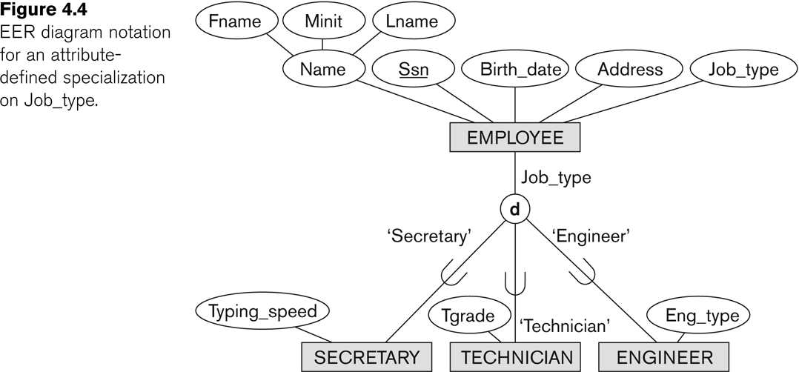
Attribute-Defined subclasses
If all subclasses in a specialization have membership condition on same attribute of the superclass, specialization is called an attribute-defined specialization
Attribute is called the defining attribute of the specialization
Example: JobType is the defining attribute of the specialization {SECRETARY, TECHNICIAN, ENGINEER} of EMPLOYEE

Slide 16
User-defined subclasses
If no condition determines membership, the subclass is called user-defined
Membership in a subclass is determined by the database users by applying an operation to add an entity to the subclass
Membership in the subclass is specified individually for each entity in the superclass by the user
Example: Person, Student, employee

Slide 17
Constraints
Two basic constraints can apply to a specialization/generalization:
Disjointness Constraint:
Completeness Constraint:

Slide 18
Constraints
Disjointness Constraint:
Disjoint
Specifies that the subclasses of the specialization must be disjoint:
an entity can be a member of at most one of the subclasses of the specialization
Specified by d in EER diagram
Overlapping
If not disjoint, specialization is overlapping:
that is the same entity may be a member of more than one subclass of the specialization
Specified by o in EER diagram

Slide 19
Constraints
Completeness (Exhaustiveness) Constraint:
Total
specifies that every entity in the superclass must be a member of some subclass in the specialization/generalization
Shown in EER diagrams by a double line
Partial
allows an entity not to belong to any of the subclasses
Shown in EER diagrams by a single line

Slide 20
Constraints on Specialization and Generalization
Hence, we have four types of specialization/generalization:
Disjoint, total
Disjoint, partial
Overlapping, total
Overlapping, partial
Note: Generalization usually is total because the superclass is derived from the subclasses.

Slide 21
Example of disjoint partial Specialization

Slide 22
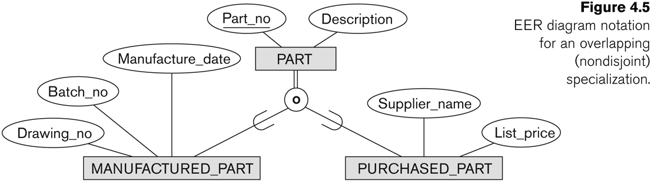
Example of overlapping total Specialization

Slide 23
Hierarchies, Lattices & Shared Subclasses
A subclass may itself have further subclasses specified on it
forms a hierarchy or a lattice
Hierarchy has a constraint that every subclass has only one superclass (called single inheritance); this is basically a tree structure
In a lattice, a subclass can be subclass of more than one superclass (called multiple inheritance)
In a hierarchy/lattice, a subclass inherits attributes and relationships not only of its direct superclass, but also of all its predecessor superclasse.

Slide 24
Shared Subclass
A subclass with more than one superclass is called a shared subclass (multiple inheritance)
Can have:
specialization hierarchies or lattices, or
generalization hierarchies or lattices,
depending on how they were derived
We just use specialization (to stand for the end result of either specialization or generalization)
Person
Similar types
Student
Employee
TA

Slide 25
Hierarchies, Lattices & Shared Subclasses (2)
In specialization, start with an entity type and then define subclasses of the entity type by successive specialization
called a top down conceptual refinement process
In generalization, start with many entity types and generalize those that have common properties
Called a bottom up conceptual synthesis process
In practice, a combination of both processes is usually employed

Slide 26
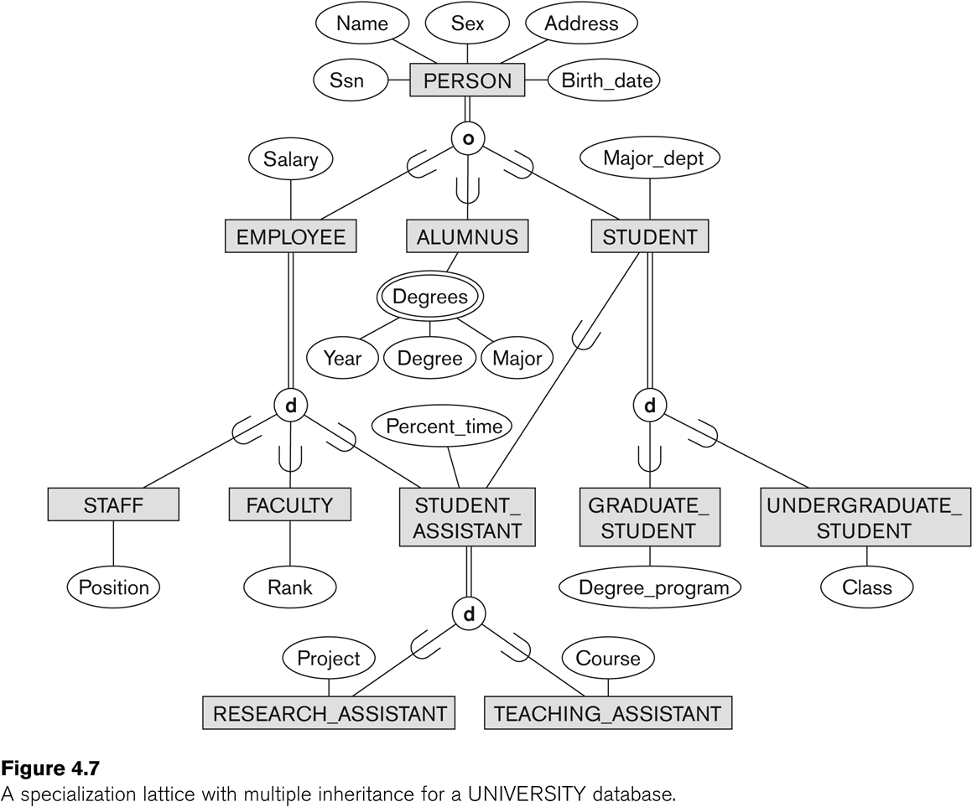
Lattice Example (UNIVERSITY)

Slide 27
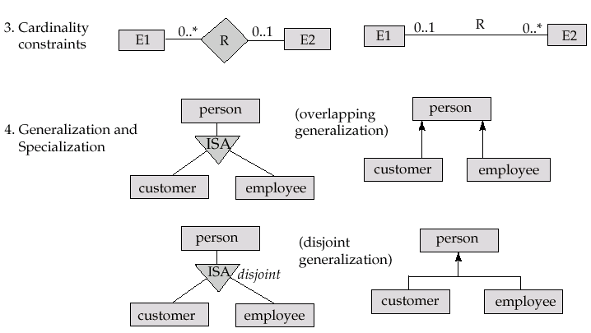
UML Class Diagram Notation (Cont.)
overlapping
disjoint
*Note reversal of position in cardinality constraint depiction
*Generalization can use merged or separate arrows independent
of disjoint/overlapping

Slide 28
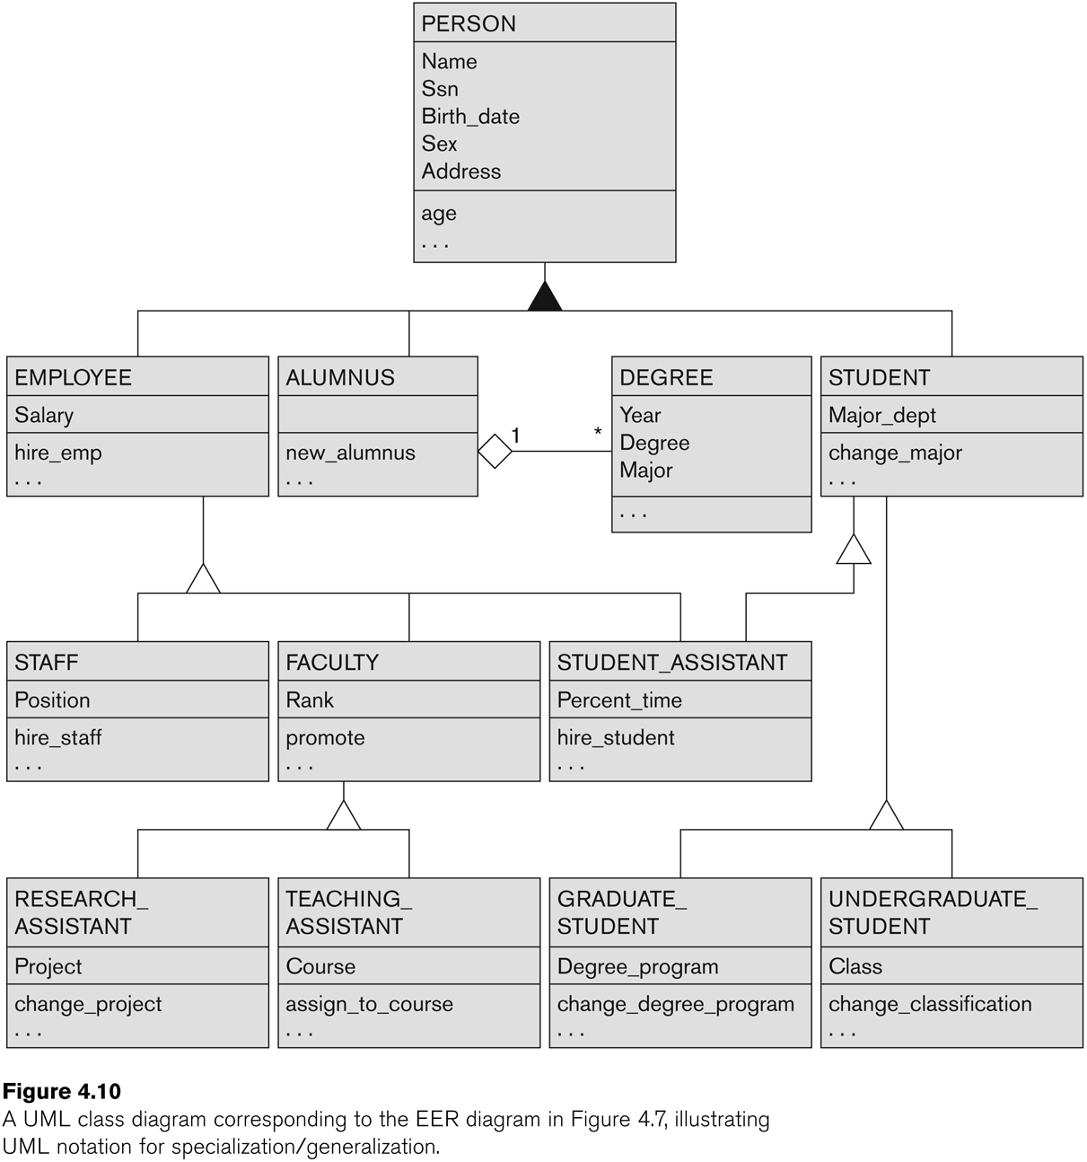
UML Example for Subclasses/Superclasses

Slide 29
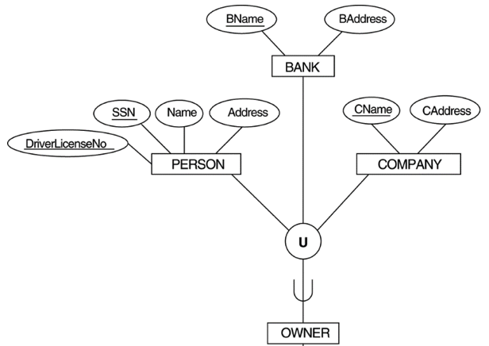
UNION TYPES (Categories)
In some cases, we need to model a subclass with more than one superclass and the superclasses can represent different entity types
Such a subclass is called a category or UNION TYPE

Slide 30
UNION TYPES (Categories) (2)
A UNION type (category) called OWNER is created to represent a subset of the union of the three superclasses COMPANY, BANK, and PERSON
A Union type member must exist in at least one of its superclasses
Difference from shared subclass, which is a:
subset of the intersection of its superclasses
shared subclass member must exist in all of its superclasses

Slide 31
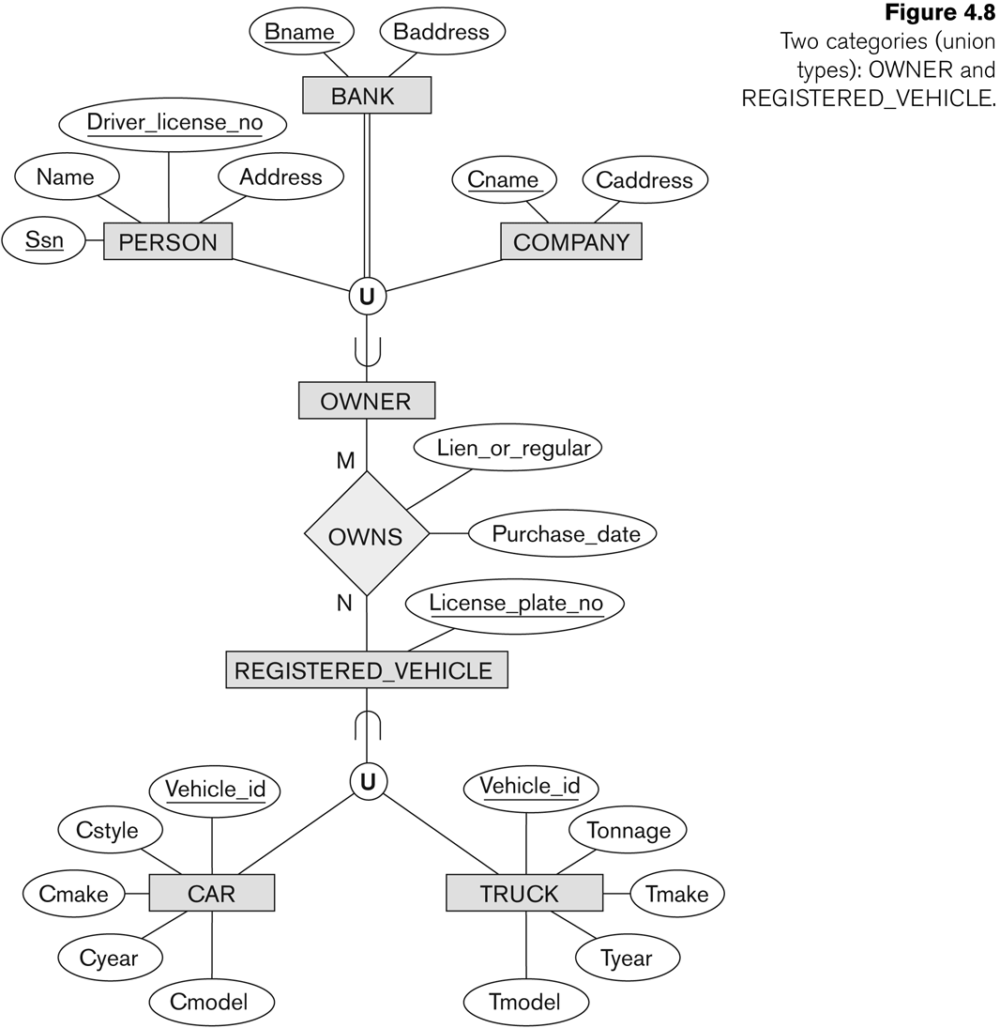
Two categories (UNION types)

Slide 32
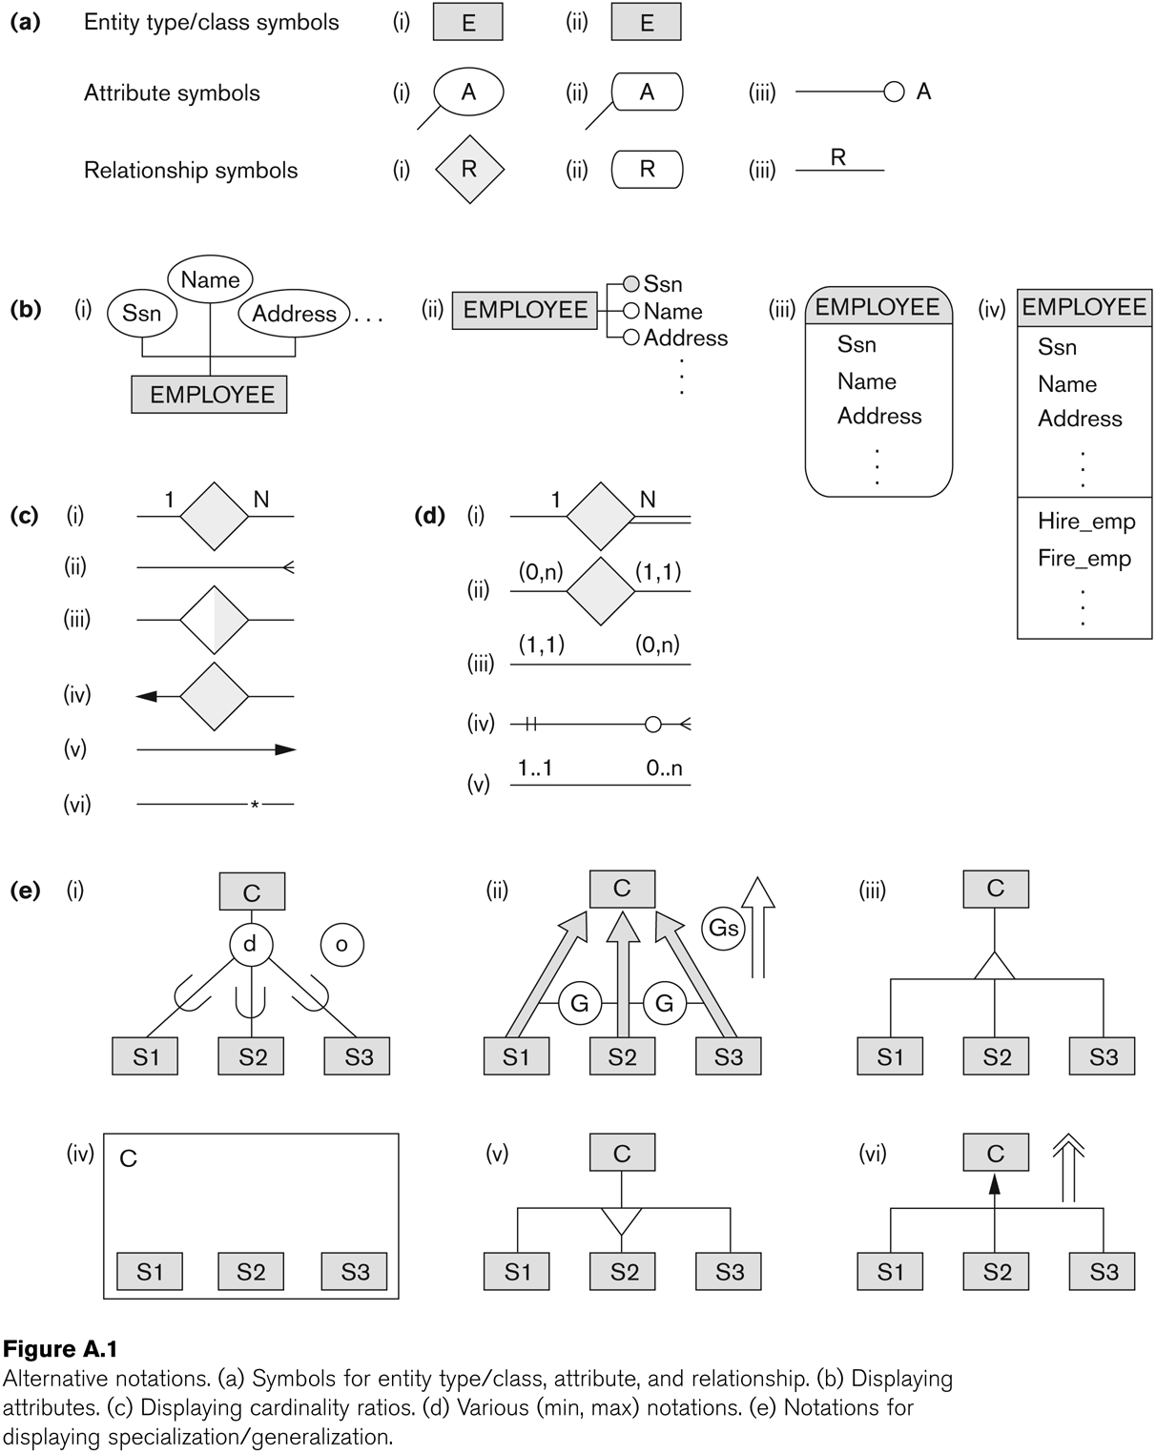
Alternative Diagrammatic Notations

Slide 33
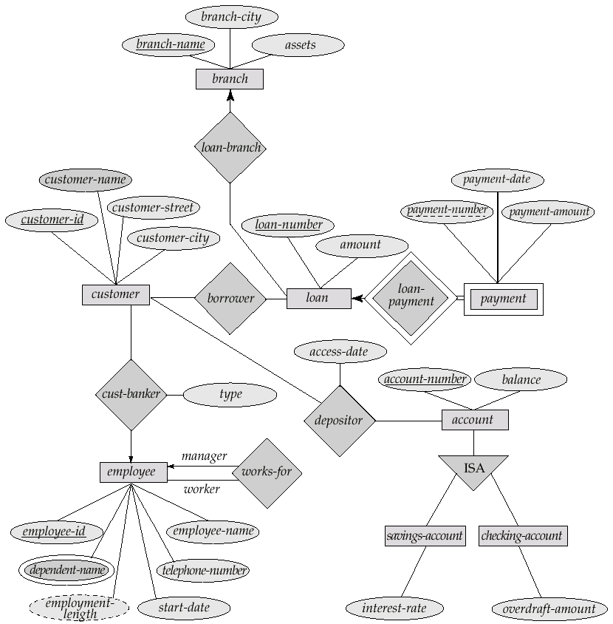
E-R Diagram for a Banking Enterprise

Slide 34
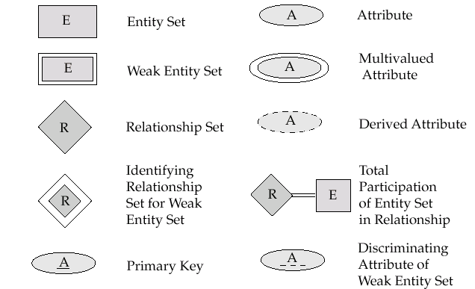
NOTATION for ER diagrams
Partial Key for
Key

Slide 35

NOTATION for ER diagrams

Slide 36
General Conceptual Modeling Concepts
GENERAL DATA ABSTRACTIONS
CLASSIFICATION and INSTANTIATION
AGGREGATION and ASSOCIATION (relationships)
GENERALIZATION and SPECIALIZATION
IDENTIFICATION
CONSTRAINTS
CARDINALITY (Min and Max)
COVERAGE (Total vs. Partial, and Exclusive (disjoint) vs. Overlapping)

Slide 37
Ontologies
Use conceptual modeling and other tools to develop “a specification of a conceptualization”
Specification refers to the language and vocabulary (data model concepts) used
Conceptualization refers to the description (schema) of the concepts of a particular field of knowledge and the relationships among these concepts
Many medical, scientific, and engineering ontologies are being developed as a means of standardizing concepts and terminology

Slide 38
Conceptual Design Using the ER Model
Design choices:
Should a concept be modeled as an entity or an attribute?
Should a concept be modeled as an entity or a relationship?
Identifying relationships: Binary or ternary? Aggregation?
Constraints in the ER Model:
A lot of data semantics can (and should) be captured.
But some constraints cannot be captured in ER diagrams.
Notes:
3

Slide 39
Design 1
name
name
Bad
MadeBy
Beer
Company
Since the company is nothing but a name, and is not at the “many” end of any relationship, it should not be an entity set.

Slide 40
Design 2
name
Company
Good
Beers
There is no need to make the company an entity set, because we record nothing about company besides their name.

Slide 41
Design 3
name
Company
ComAddr
Bad
Beers
This design repeats the manufacturer’s address once for each beer and loses the address if there are temporarily no beers for a manufacturer.

Slide 42
Design 4
name
name
addr
MadeBy
Beer
Company
Bad
Company
This design states the manufacturer of a beer twice: as an attribute and as a related entity.

Slide 43
Design 5
name
name
addr
MadeBy
Beer
Company
Good
This design gives the address of each manufacturer exactly once.
Company deserves to be an entity set because of the nonkey attribute addr.
Beers deserves to be an entity set because it is the “many” of the many-one relationship MadeBy.

Slide 44
Entity Sets Versus Attributes
An entity set should satisfy at least one of the following conditions:
It is more than the name of something; it has at least one nonkey attribute.
or
It is the “many” in a many-one or many-many relationship.

Slide 45
Entity vs. Attribute
Should address of an employee be
an attribute of Employee?
an entity connected to Employee by a relationship?
Depends upon the use we want to make of address information, and the semantics of the data:
Employee
Address
Lives
Employee
Address

Slide 46
Entity vs. Attribute
Depends upon the use we want to make of address information, and the semantics of the data:
If an address is just a value, must be an atomic attribute.
If we have several addresses per employee, address must be a multi-value attribute.
If the structure (city, street, etc.) is important, e.g., we want to retrieve employees in a given city, address must be modeled as a composite attribute.

Slide 47
Entity vs. Attribute (Contd.)
Works_In does not allow an employee to work in a department for two or more periods (a relationship is identified by participating entities).
Similar to the problem of wanting to record several addresses for an employee: We want to record several values of the descriptive attributes for each instance of this relationship. Accomplished by introducing new entity set, Duration.
from
to
name
dname
ssn
lot
did
budget
Employees
Works_In
Departments
name
dname
ssn
lot
did
budget
Employees
Works_In
Departments
from
Duration
to
Notes:
5

Slide 48
Binary vs. Ternary Relationships
name
ssn
lot
pname
age
Employees
Covers
Dependents
Bad design for the additional requirements
Policies
policyid
cost
This ER diagram expresses the following requirements :
An employee can own several policies.
Each policy can be owned by several employees.
Each dependent can be covered by several policies.
The ER diagram doesn’t express the following requirements:
A policy cannot be covered jointly by 2 or more employees.
Every policy must be covered by some employee.
Dependents is a weak entity set with partial key “pname” and identified by the primary key of Policies.
Which constraints would capture the additional requirements?
Notes:
7

Slide 49
Binary vs. Ternary Relationships
Suppose:
A policy cannot be owned by more than one employee.
Every policy must be owned by some employee.
Dependent is a weak entity set, identified by policiId.
name
ssn
lot
pname
age
Employees
Covers
Dependents
Bad design
Policies
policyid
cost
name
pname
age
ssn
lot
Dependents
Employees
Purchaser
Beneficiary
Good design
Policies
two binary relationships were better than one ternary relationship.
policyid
cost
Notes:
7

Slide 50
Entity vs. Relationship
Should an attribute be descriptive or not?
The ER diagram depicts the situation where a manager gets a separate discretionary budget for each dept.
What if a manager gets a discretionary budget that covers all managed depts?
Redundancy: dbudget stored for each dept managed by manager.
Misleading: Suggests dbudget associated with department-mgr combination.
since
dbudget
name
dname
ssn
lot
did
budget
Employees
Manages
Departments
name
ssn
lot
since
dname
Employees
did
budget
Manages
Departments
ISA
This fixes the
problem!
Managers
dbudget

Slide 51
Don’t Overuse Weak Entity Sets
Beginning database designers often doubt that anything could be a key by itself.
They make all entity sets weak, supported by all other entity sets to which they are linked.
In reality, we usually create unique ID’s for entity sets.
Examples include social-security numbers, automobile VIN’s etc.

Slide 52
When Do We Need Weak Entity Sets?
The usual reason is that there is no global authority capable of creating unique ID’s.
Example: it is unlikely that there could be an agreement to assign unique player numbers across all football teams in the world.

Slide 53
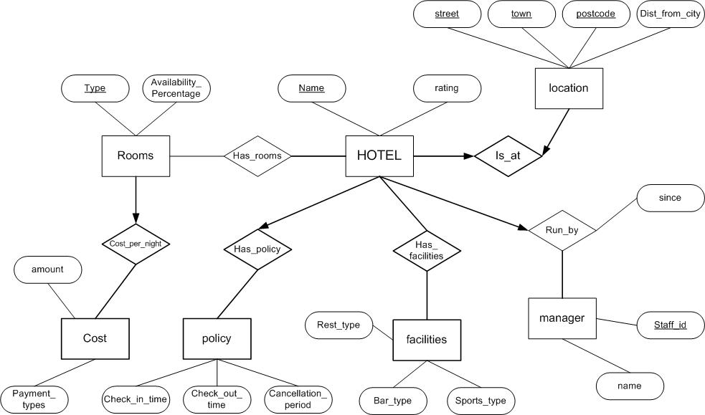
ERD Examples

Slide 54
Summary of Conceptual Design
Conceptual design follows requirements analysis,
Yields a high-level description of data to be stored
ER model popular for conceptual design
Constructs are expressive, close to the way people think about their applications.
It is a semantic model !
Basic constructs are: entities, relationships, and attributes (of entities and relationships).
Some additional constructs are: weak entities, ISA hierarchies, and aggregation.
There are many variations of ER model in the literature.

Slide 55
Summary of ER (Contd.)
ER design is subjective. There are often many ways to model a given scenario! Analyzing alternatives can be tricky, especially for a large enterprise.
Common choices include:
strong vs. weak entity.
Entity vs. attribute, entity vs. relationship,
binary or n-ary relationship,
whether or not to use ISA hierarchies, and
whether or not to use aggregation.
Notes:
13

Slide 56
Summary of ER (Contd.)
Several kinds of integrity constraints can be expressed in the ER model:
key constraints,
participation constraints, and
overlap/covering constraints for ISA hierarchies.
Some foreign key constraints are also implicit in the definition of a relationship set.
Some constraints (notably, functional dependencies) cannot be expressed in the ER model.
Constraints play an important role in determining the best database design for an enterprise.
Notes:
12

Slide 57
NOTATION for ER diagrams
Partial Key
Key

Slide 58
NOTATION for ER diagrams

